Slide 1
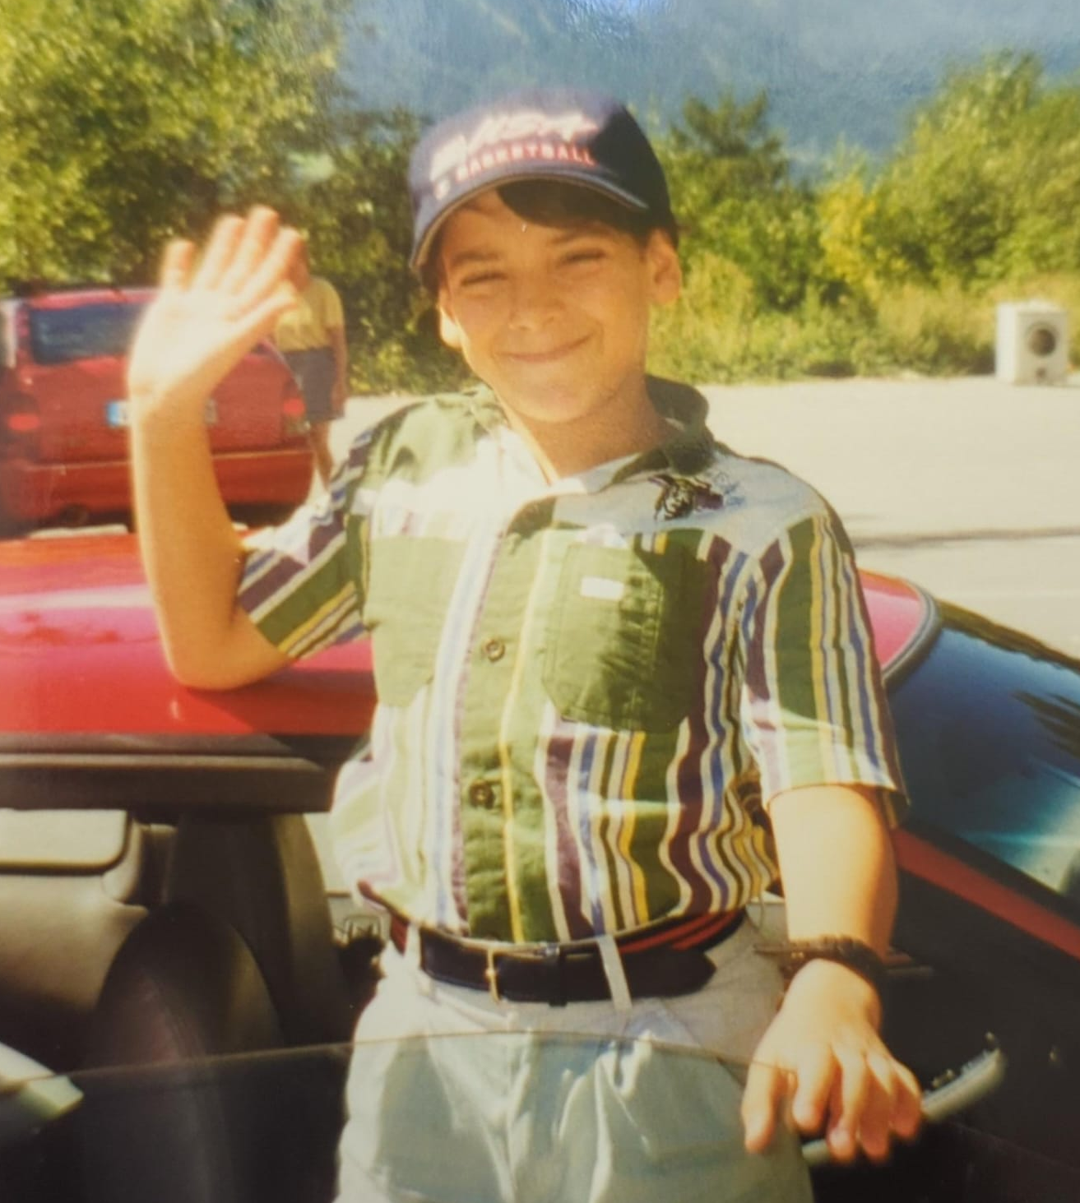
Alessandro Echevarria
Alessandro Echevarria is an Illustrator raised by a pack of wild TVs at the foot of the Italian Alps, and his work is deeply influenced by animation. Through the use of traditional media techniques in a digital space, and the language of cartooning, his work comments on class, history, and politics with wry wit.
A reformed advertising creative, he’s experienced working with AAA clients like Duracell, Delta, Nike, or Lyft, as well as local educational non-profits helping kids stay busy and out of trouble.
Web: https://lamekids.club/
Ig: @skulldaggery
Photo/Headshot

Slide 2
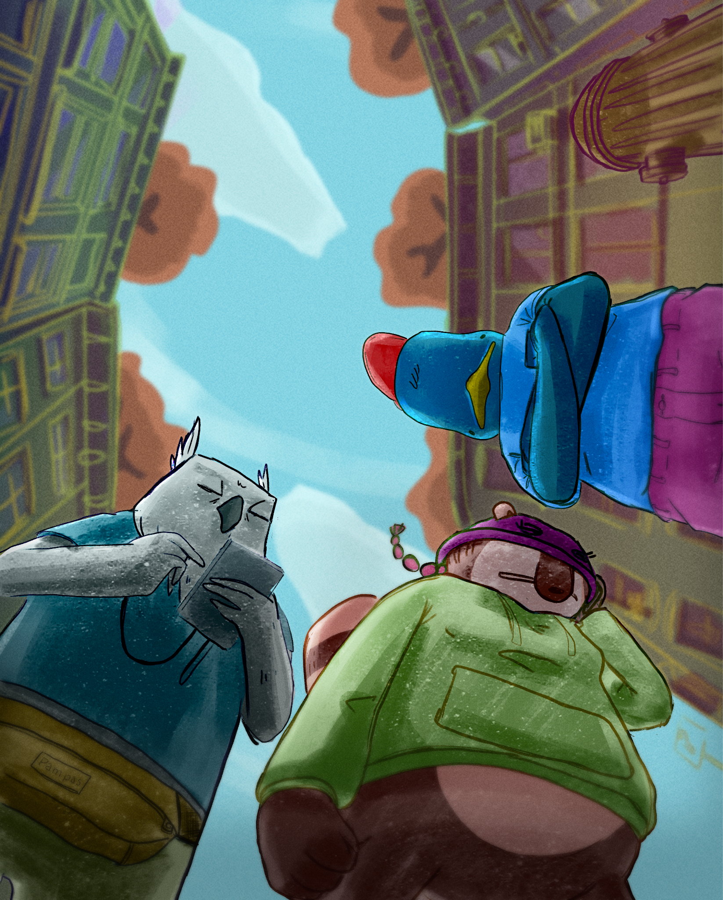
Grownass Baby Bird
Drawing has been an integral part of my life since before I can remember, and growing up in a household with two working parents, so was the television. I spent hours watching animations from France and the US, but for the most part from Japan, primarily from the 70s and 80’s. To say I was deeply influenced, is an understatement, I was baptized, christened, and anointed by the holy blue glow of the cathode ray tube. My obsession with animation remained with me into adulthood. This thesis work is a pitch for my own animated series. The show centers around Percy, the titular grownass baby bird, never pushed by his parents to follow any particular path, which included never being pushed out of the nest, literally… He never learned how to fly. Supported by Fran, Percy’s self appointed best friend, a rakish street wise racoon, always scheming her next hustle, and Percy’s college buddy Fred the friendly giant owl, an industrious gig worker with a distinctive sleepy look. Using a class conscious lens the show provides both a window and a mirror into the contradictions of modern society, a playful satire about what it means to be working class in the 21st century.

Slide 3
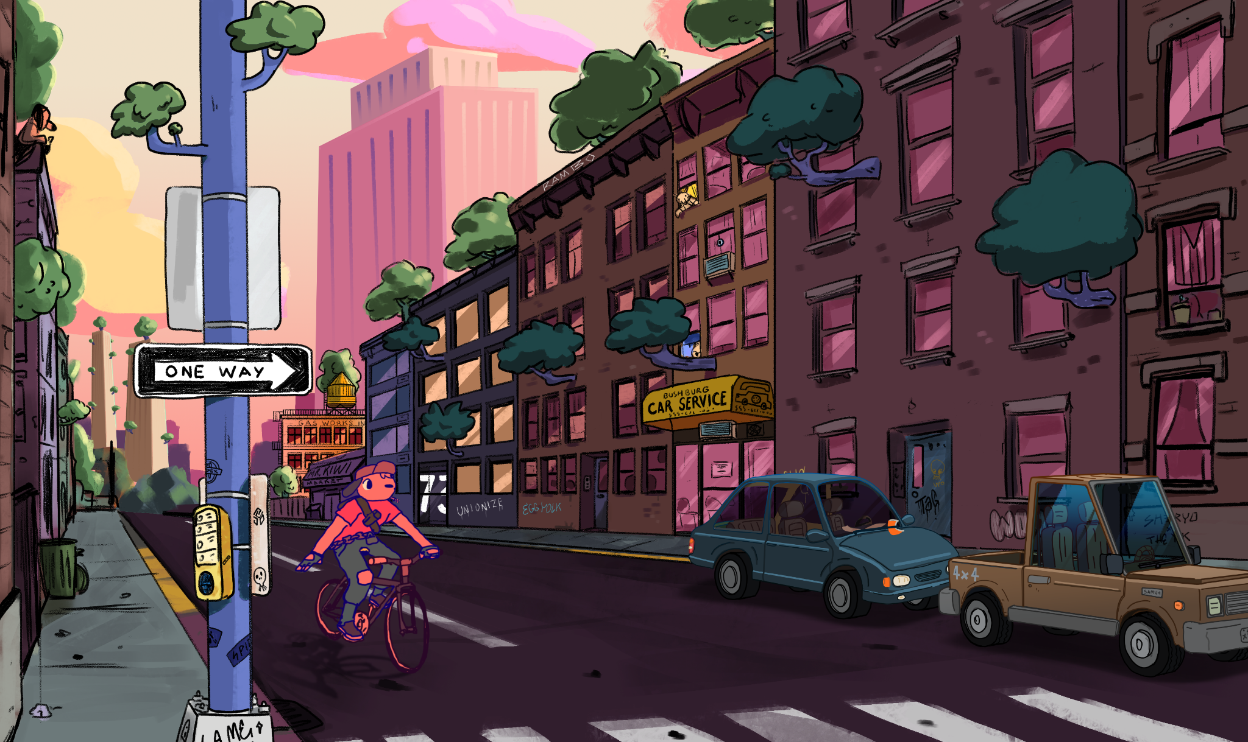
Sylvan City Street
Digital
15”x9”
Key art depicting tone and details of the world the series takes place in.

Slide 4
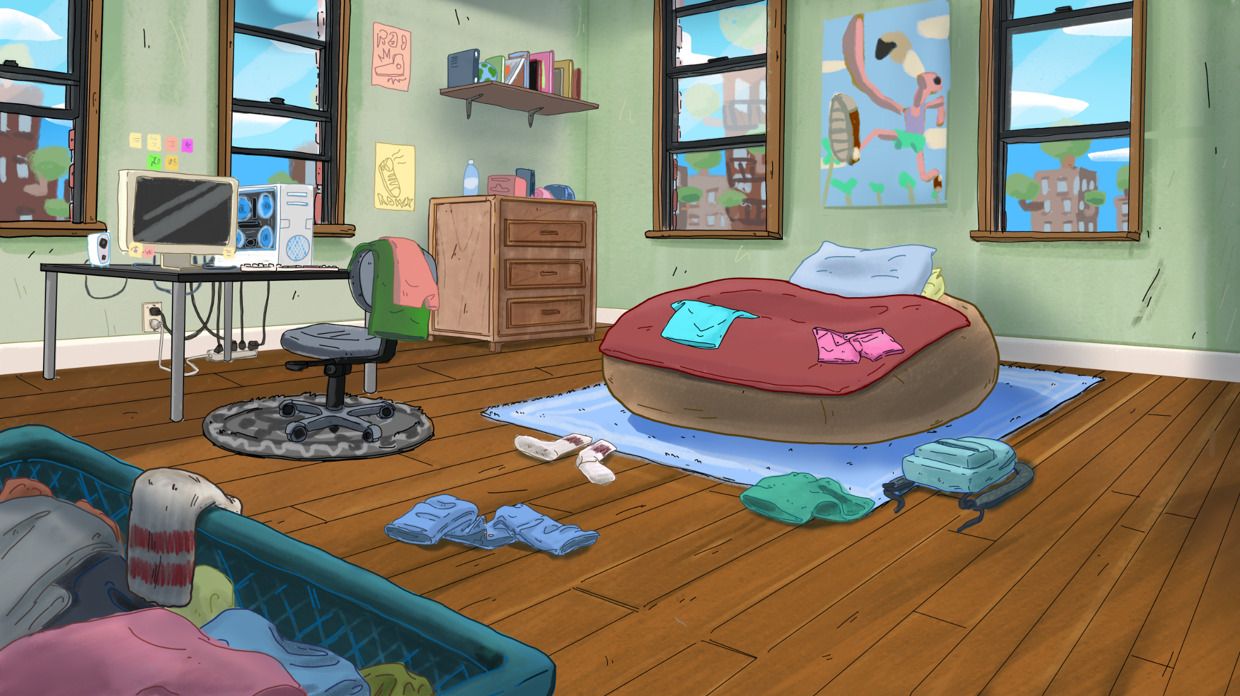
Final Art Sample 3
Percy’s Bedroom
Digital
17”x9.5”
Background art design for animation, depicting main character’s bedroom

Slide 5
Final Art Sample 3
Menace
Digital
16.25”x20”
Poster illustration of Percy and his friends getting into some trouble

Slide 6
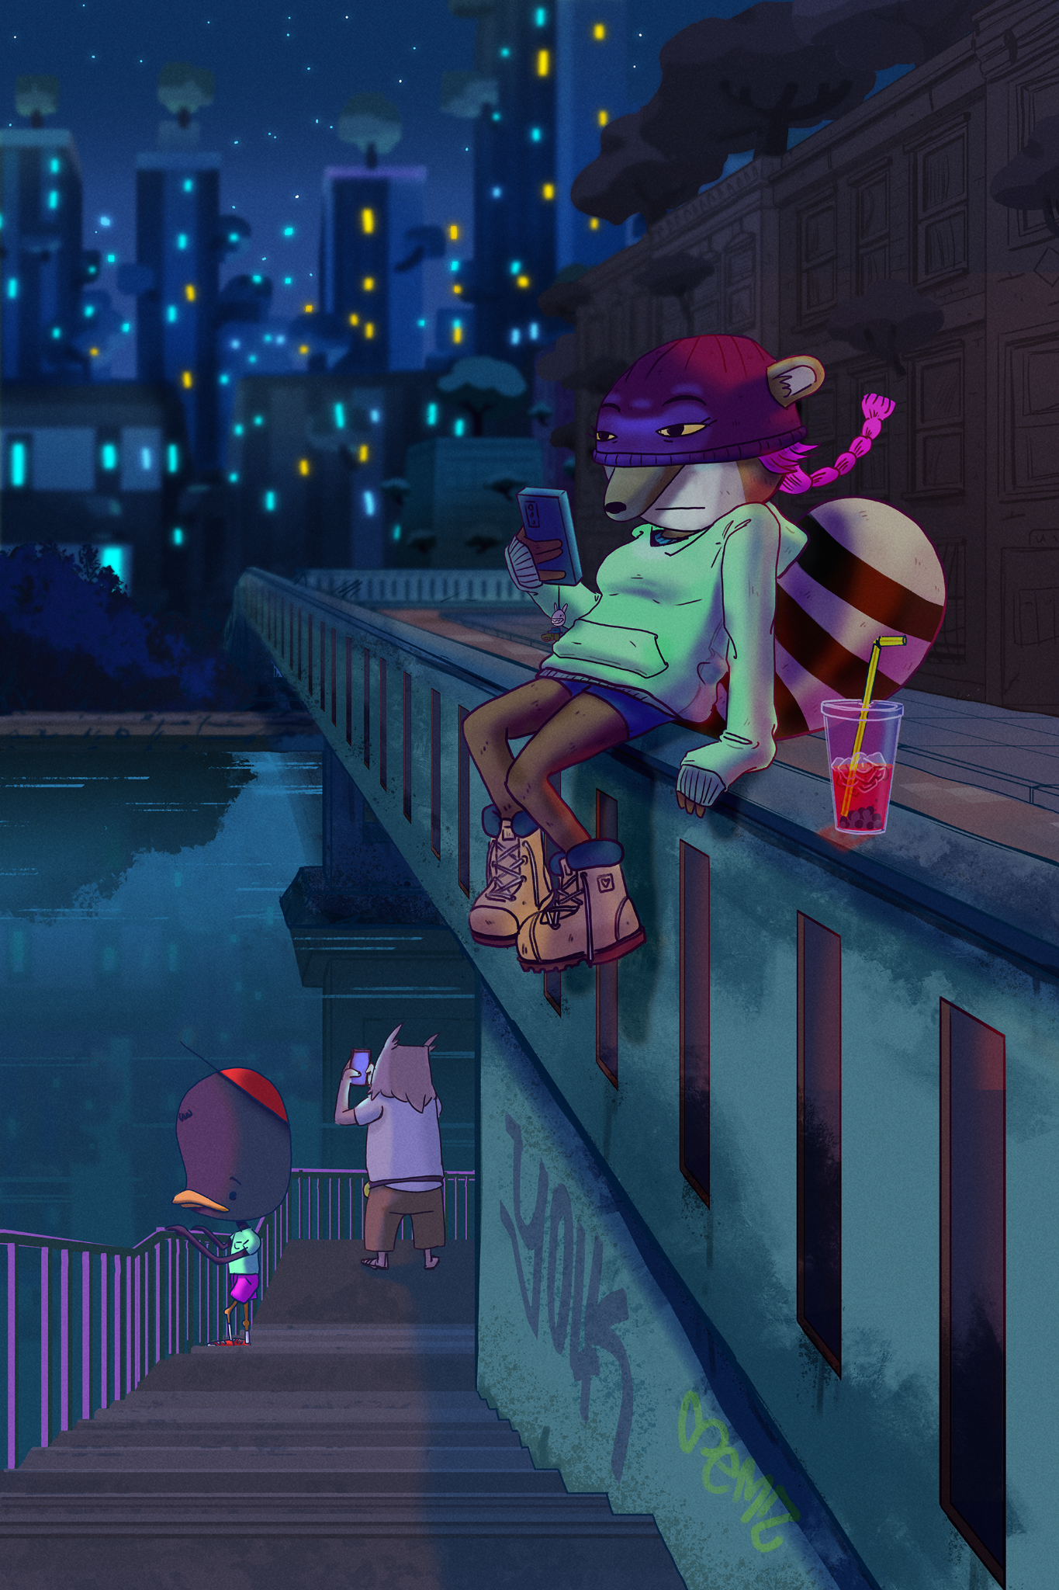
Final Art Sample 3
City nights
Digital
13.3”x20”
Poster illustration of the group on a late night hang

