Slide 1
Christina Lee
Christina Lee is a Korean-American illustrator and designer based in Brooklyn, NY by way of San Jose, CA and Pittsburgh, PA. A graduate of Carnegie Mellon University’s School of Art, she is a co-founder of Pullproof Studio, a community screenprinting studio, and Alright Editions, a small press. Her prints, zines, animations, and comics are defined by expressive mark making, concise compositions, and colorfully absurd subjects. Her select clients include The New York Times, LA Times, Bloomberg Businessweek, and American Greetings. She has exhibited at Comic Arts Brooklyn, Small Press Expo, Feminist Zine Fest, and LA Zine Fest, and her work has been recognized by the Society of Illustrators and American Illustration. She teaches in the Illustration undergraduate department at the Fashion Institute of Technology.
www.xtinalee.com
www.instagram.com/xxtinalee
Photo/Headshot
Photograph by Shaun Lucas

Slide 2
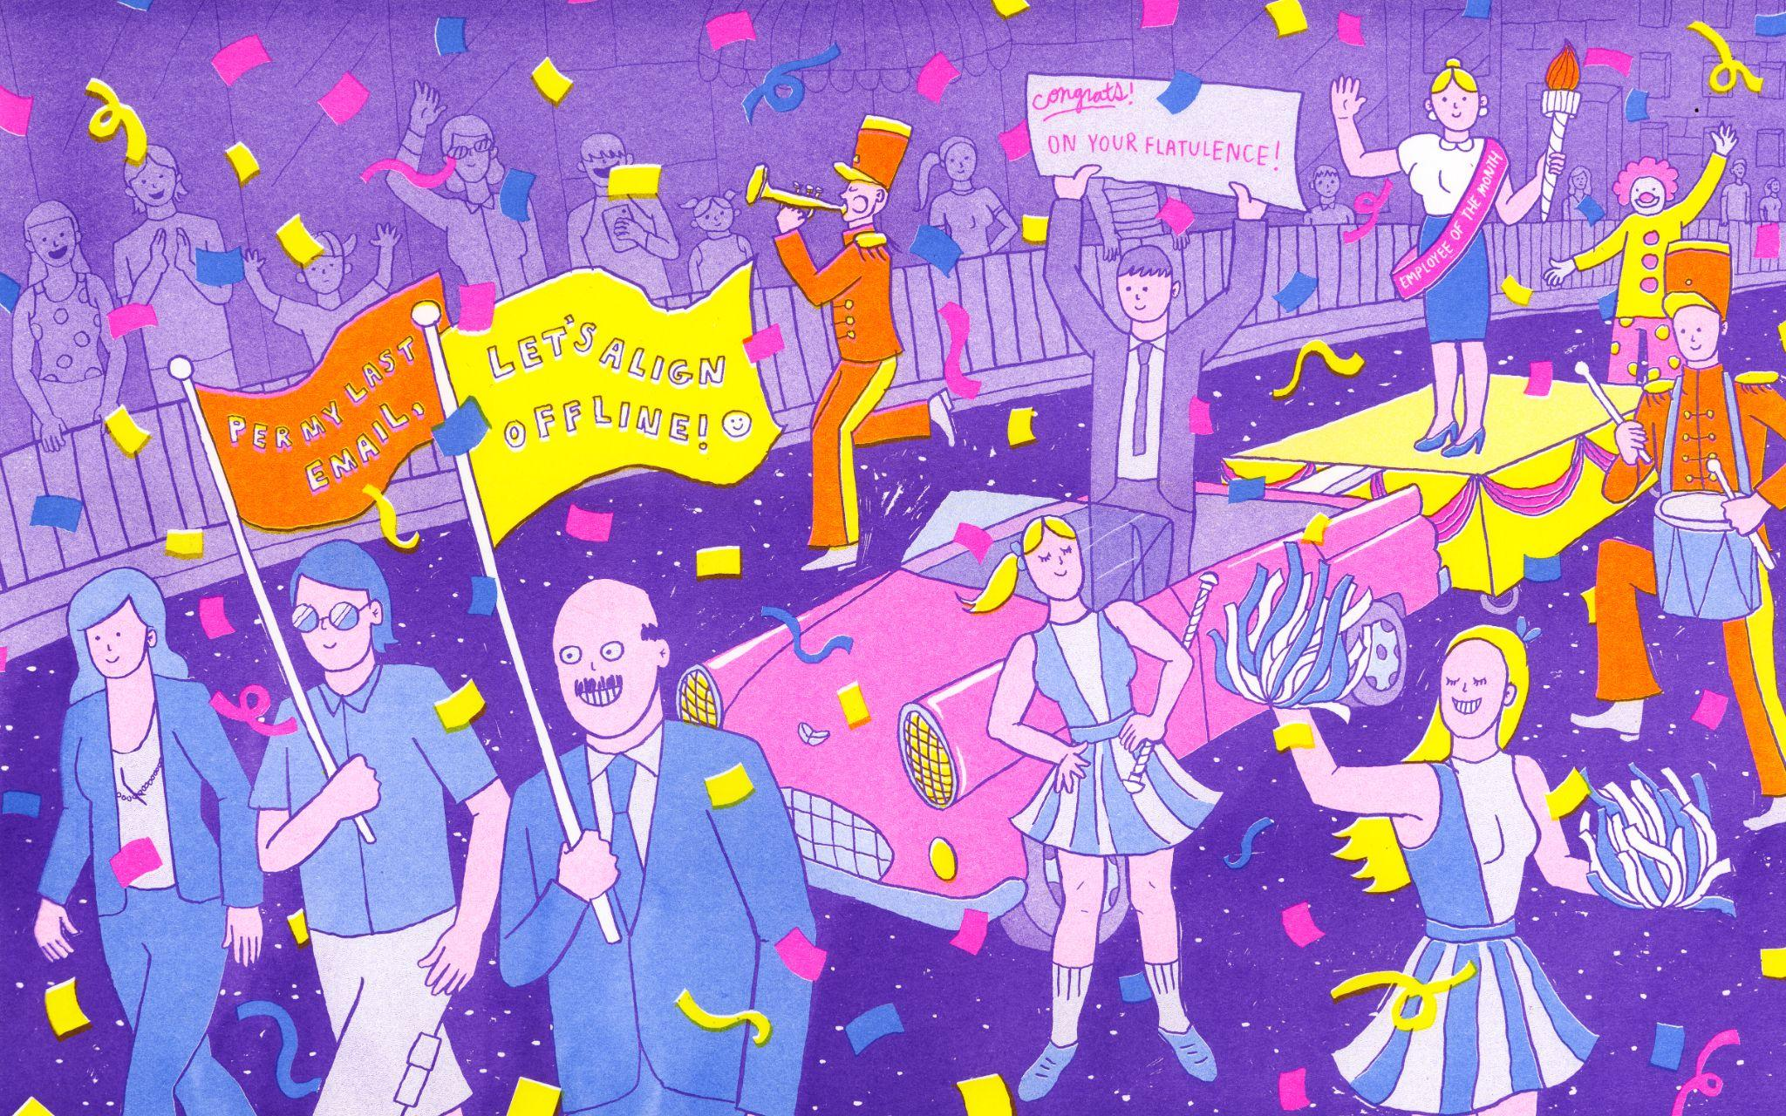
The Method
I love celebrity culture because of its ubiquity. I’m fascinated by its effect on people, as fame seems more attainable than it’s ever been before. The Method is a 44-page 7-color risograph printed zine that explores stardom, authenticity, and “hustle” culture through three short fictional comics; each presenting a funhouse mirror reflection of the modern world. Each page was inked traditionally, then reproduced with the risograph printer’s fluorescent inks. The title is in reference to method acting, as I found myself using a similar technique in this first attempt at writing fiction: my own experiences informed my characters’ inner motivations and emotions, resulting in absurd narratives that still feel highly personal to me.
I choose comics as the medium to convey complex ideas: pulling from my interdisciplinary art background, I use words, images, sequence, and repetition to create work with humorous yet challenging themes. Through these means, I am exploring more nuanced and intricate ways of engaging with my audience. As a printmaker, the accessibility of comics resonates with me too; I enjoy how the medium can synthesize a narrative ready for mass and expeditious consumption. I hope my stories will provoke you into laughing, crying, and saying “Ew!”

Slide 3
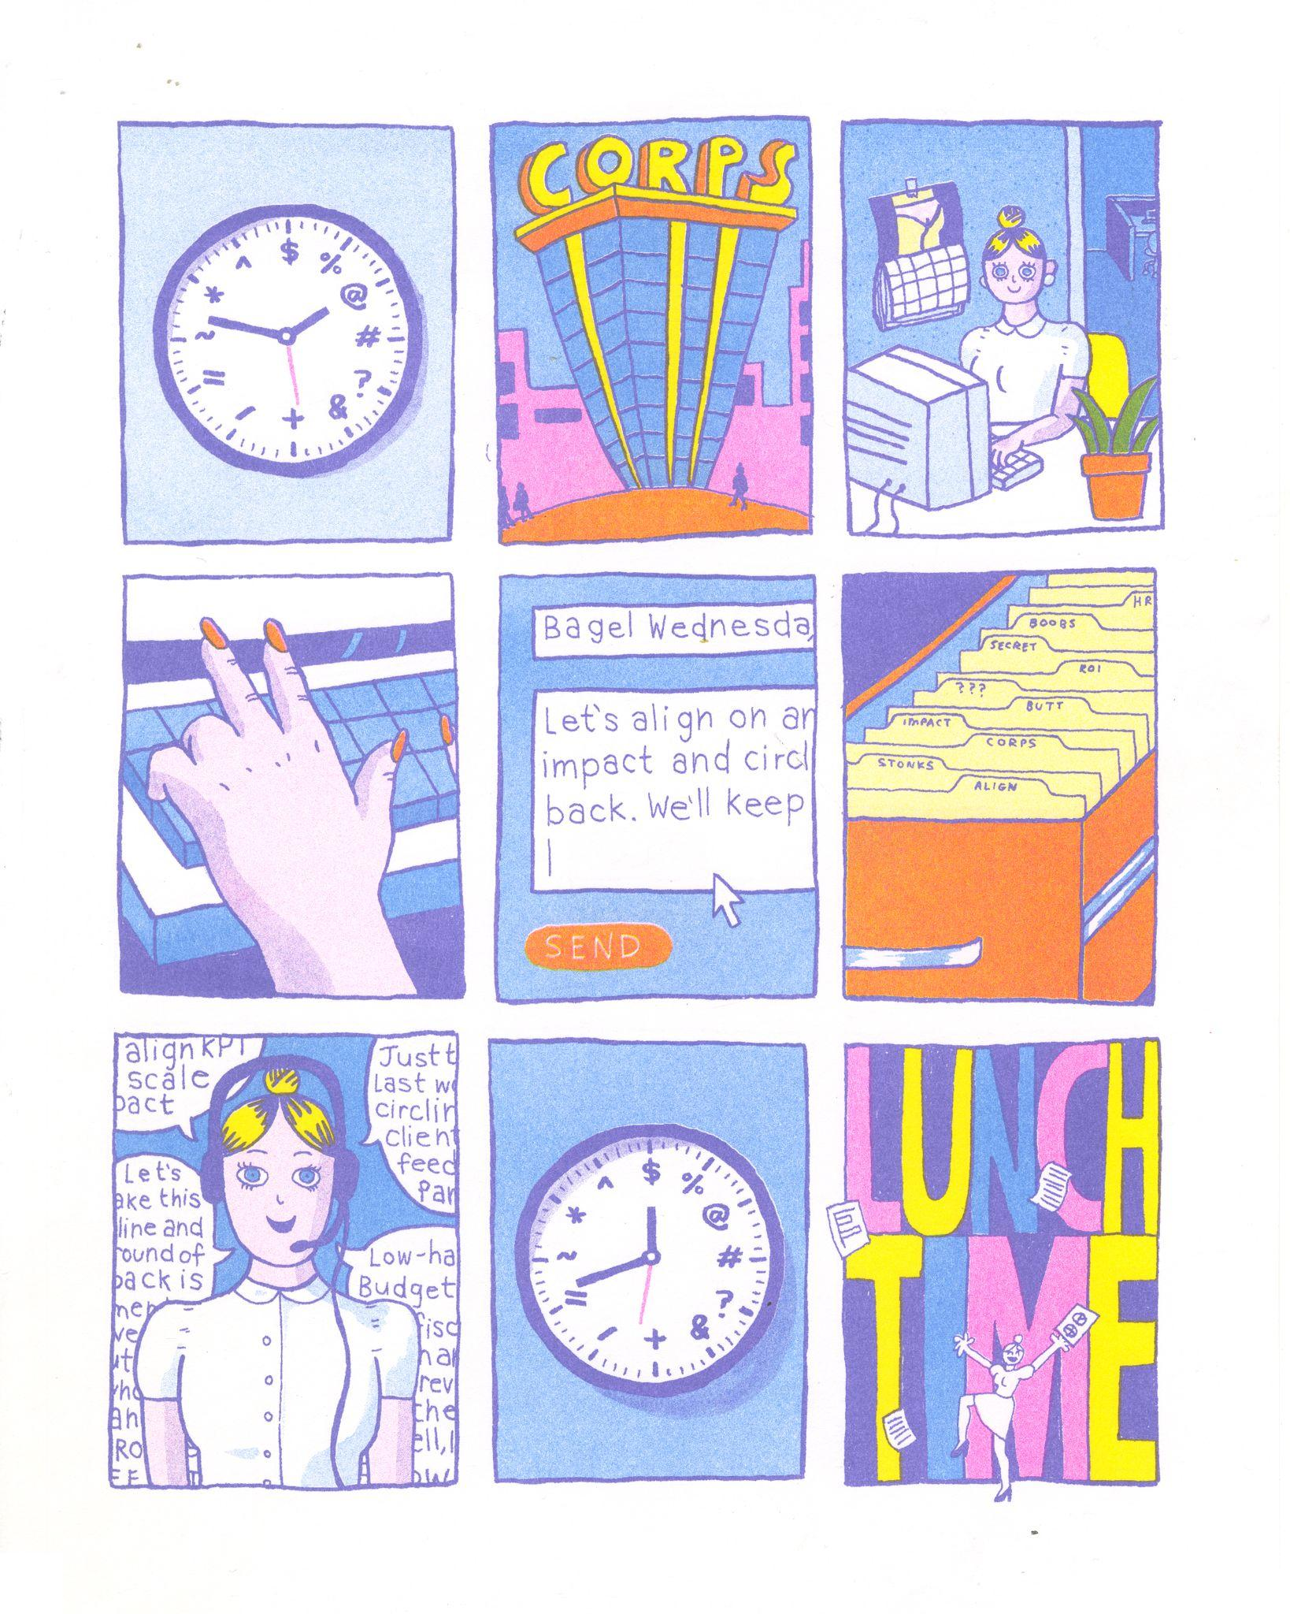
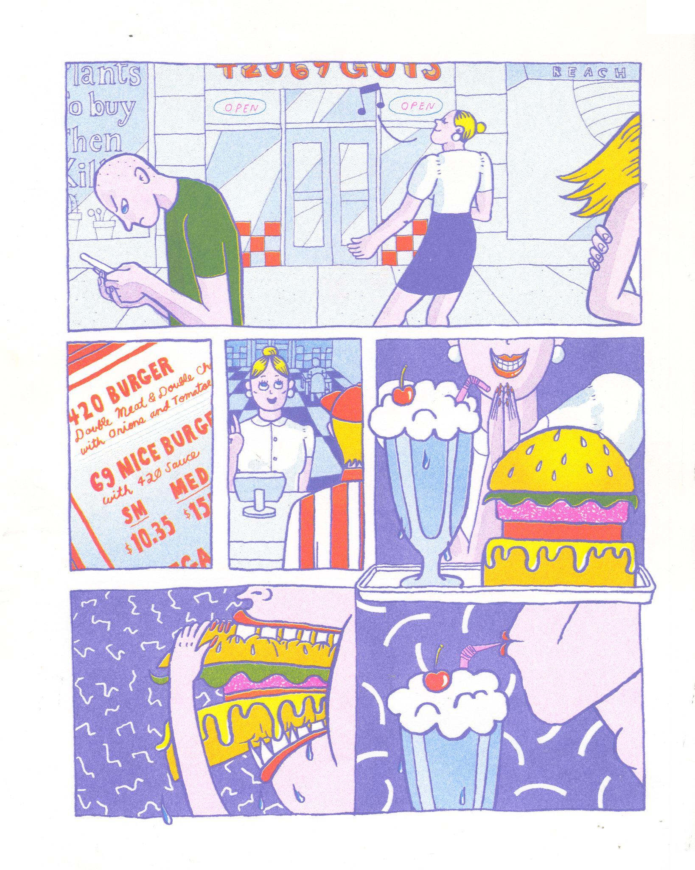
Pages from “Employee of the Month”
4-color Risograph Print
8x10”
Brief description only of necessary

Slide 4
Final Art Sample 1
Congrats! On Your Flatulence!
4-color Risograph Print
10x16”

Slide 5
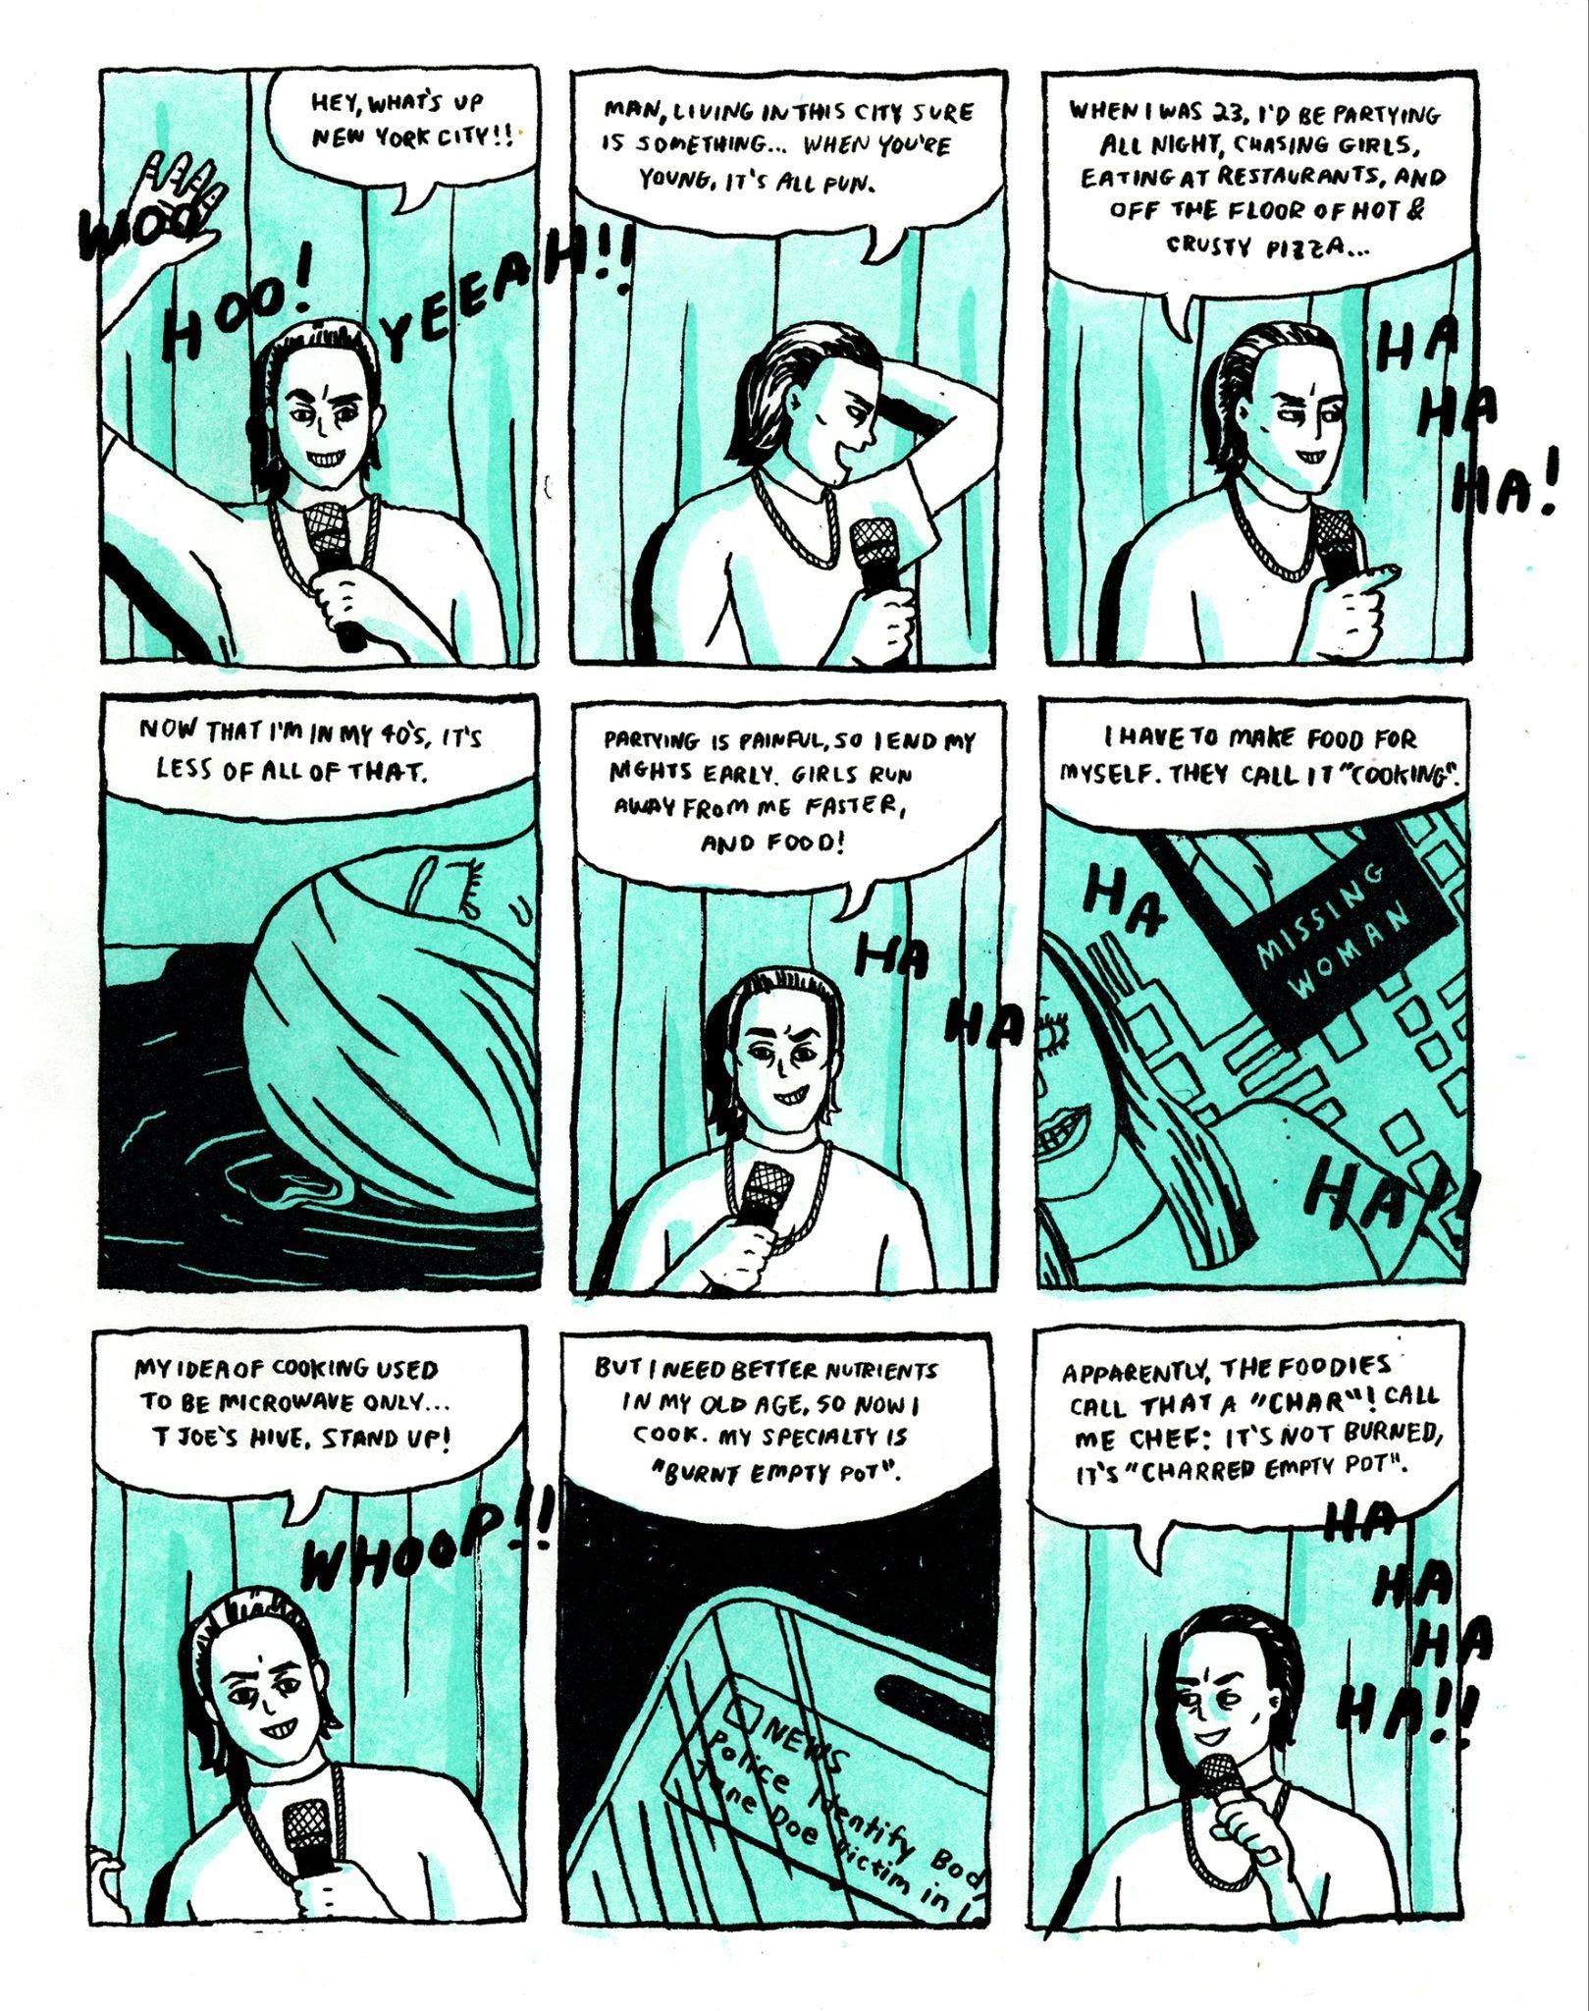
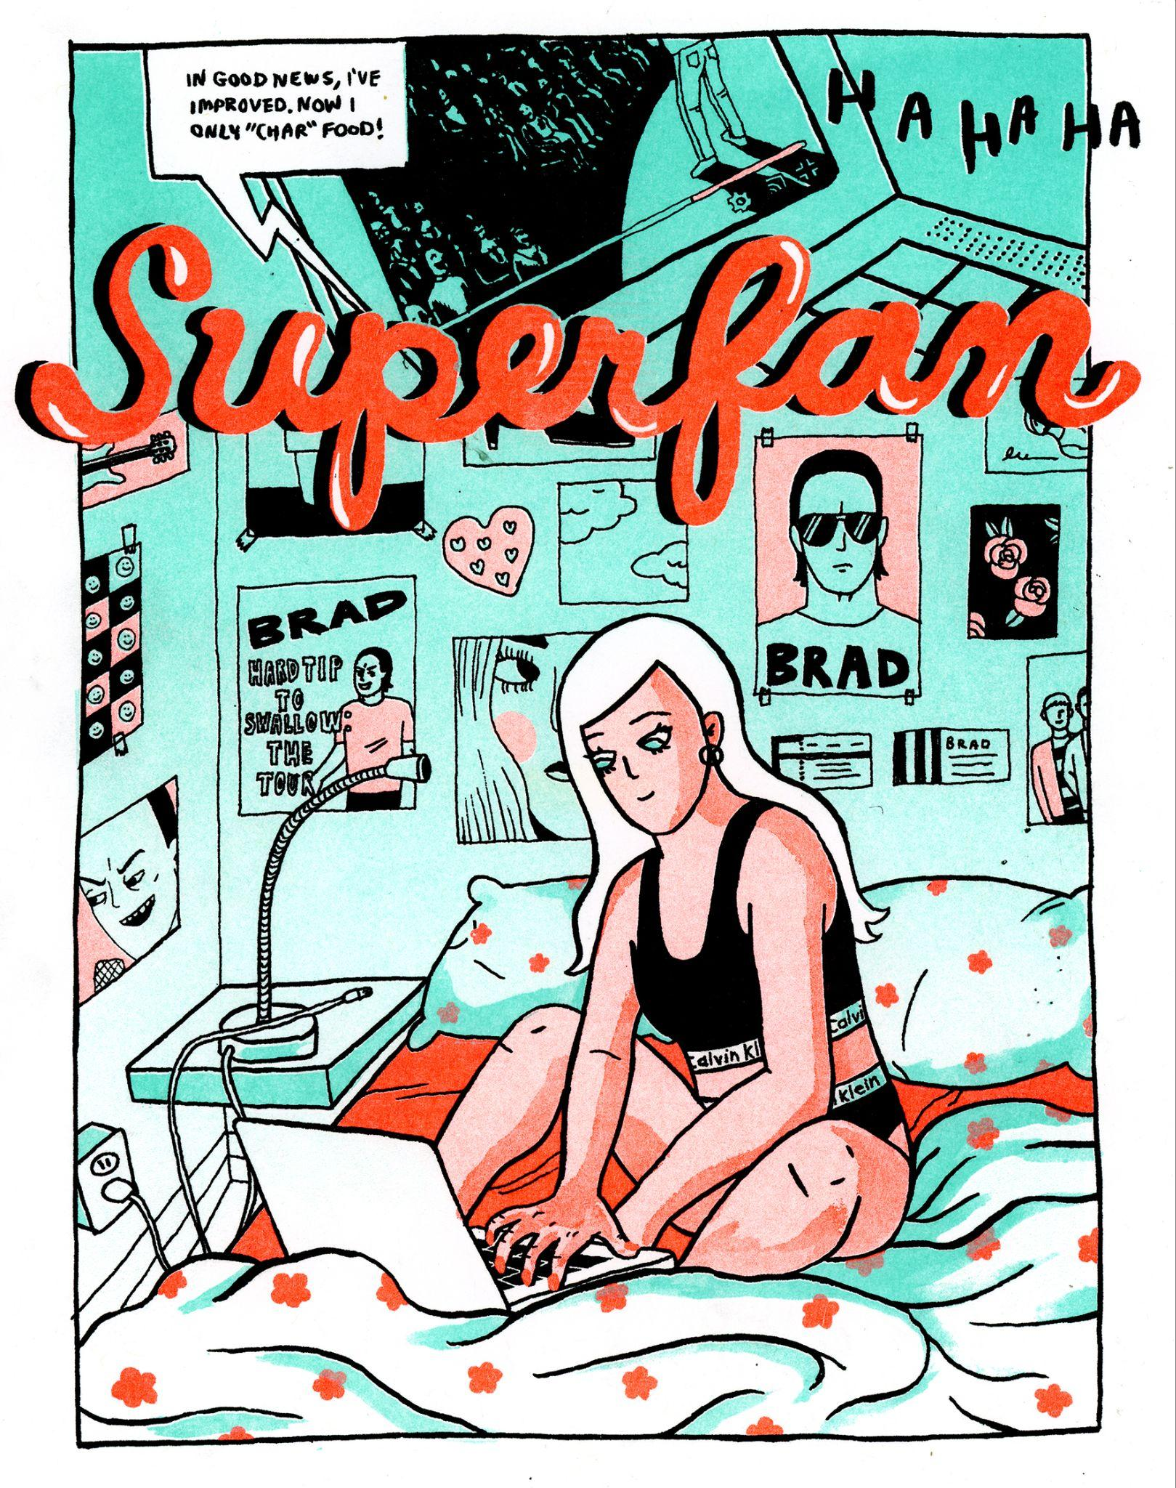
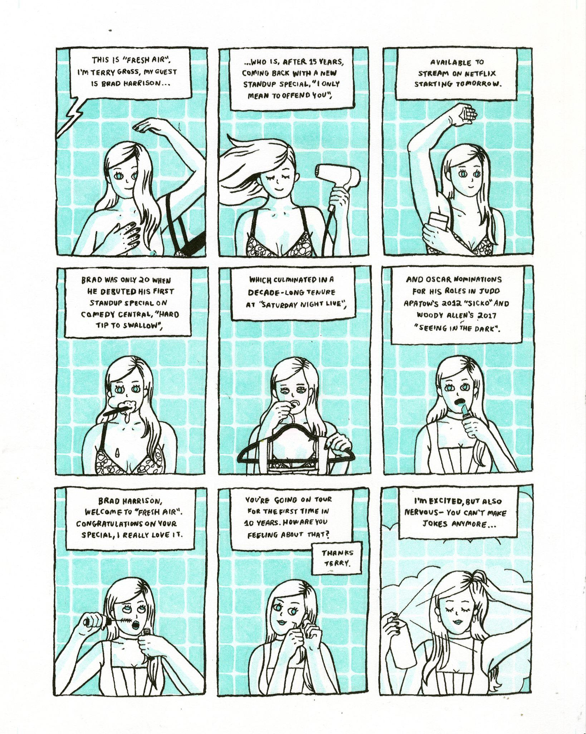
Pages from “Superfan”
2-color Risograph Print
8x10” each

Slide 6
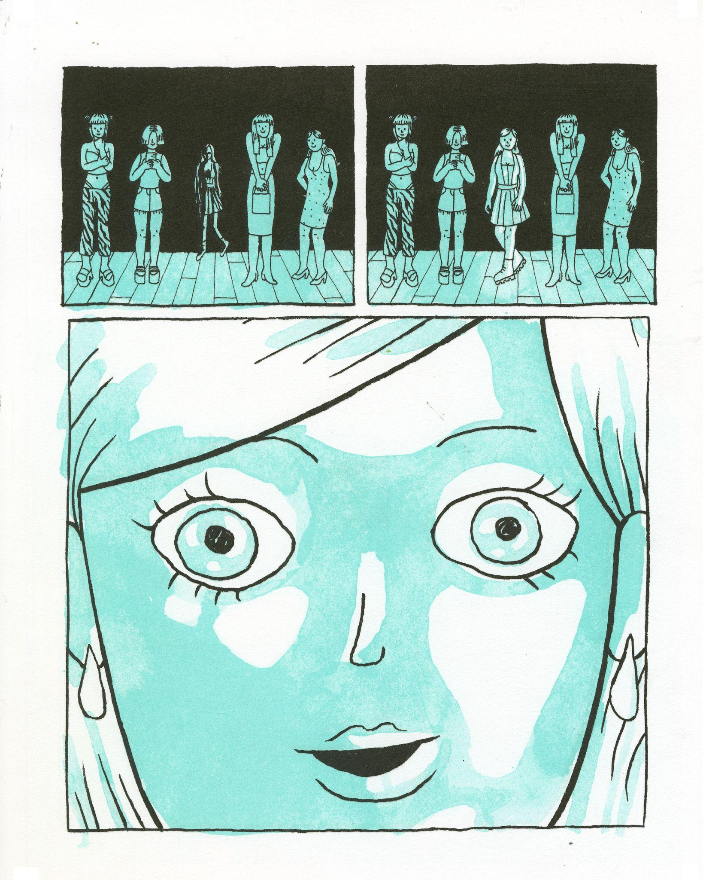
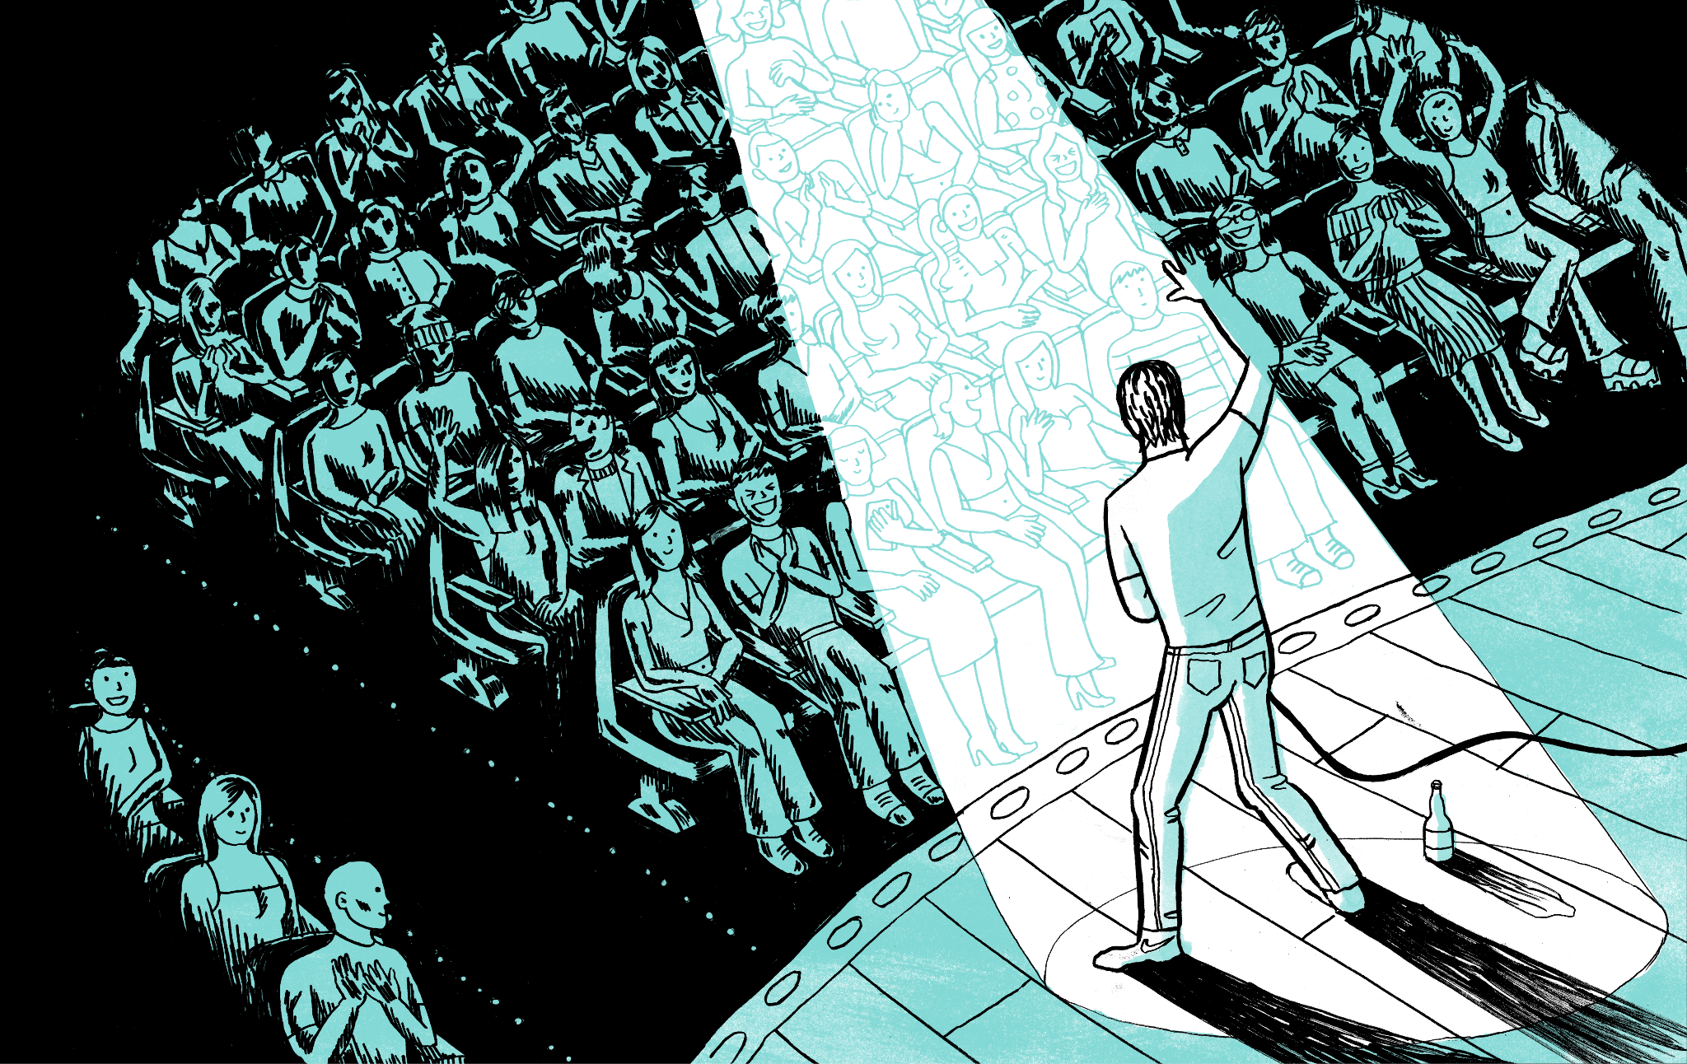
Pages from “Superfan”
2-color Risograph Print
8x10” and 16x10”

