Slide 1
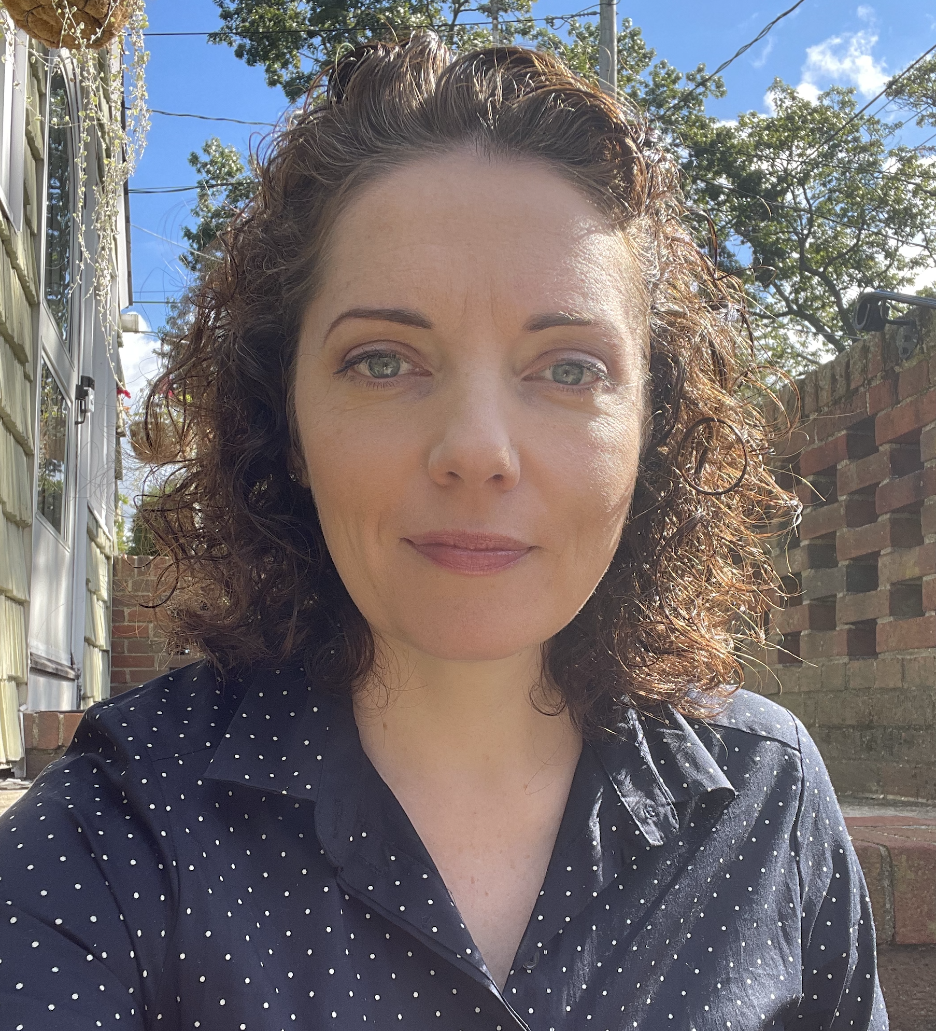
DIANA O’BRIEN
I live in Huntington, NY, on Long Island with my husband John and our children, Grace, 6, and Declan, 3. I got an AAS degree from FIT in ‘99, and a BA in Visual Communications from SUNY Farmingdale in ‘04. I have worked as a graphic designer for Motorola and other corporations, as well as a muralist in children’s hospitals, and an illustrator. Currently I am head of marketing a global company. I am the founder of Authors of Hope, a (501c3 pending) nonprofit publishing house that serves children who have stories to tell.
Web: www.dianaobrienart.com / www.authorsofhope.org
Ig: @dianaobrienart / @AuthorsOfHopeBooks
Photo/Headshot

Slide 2
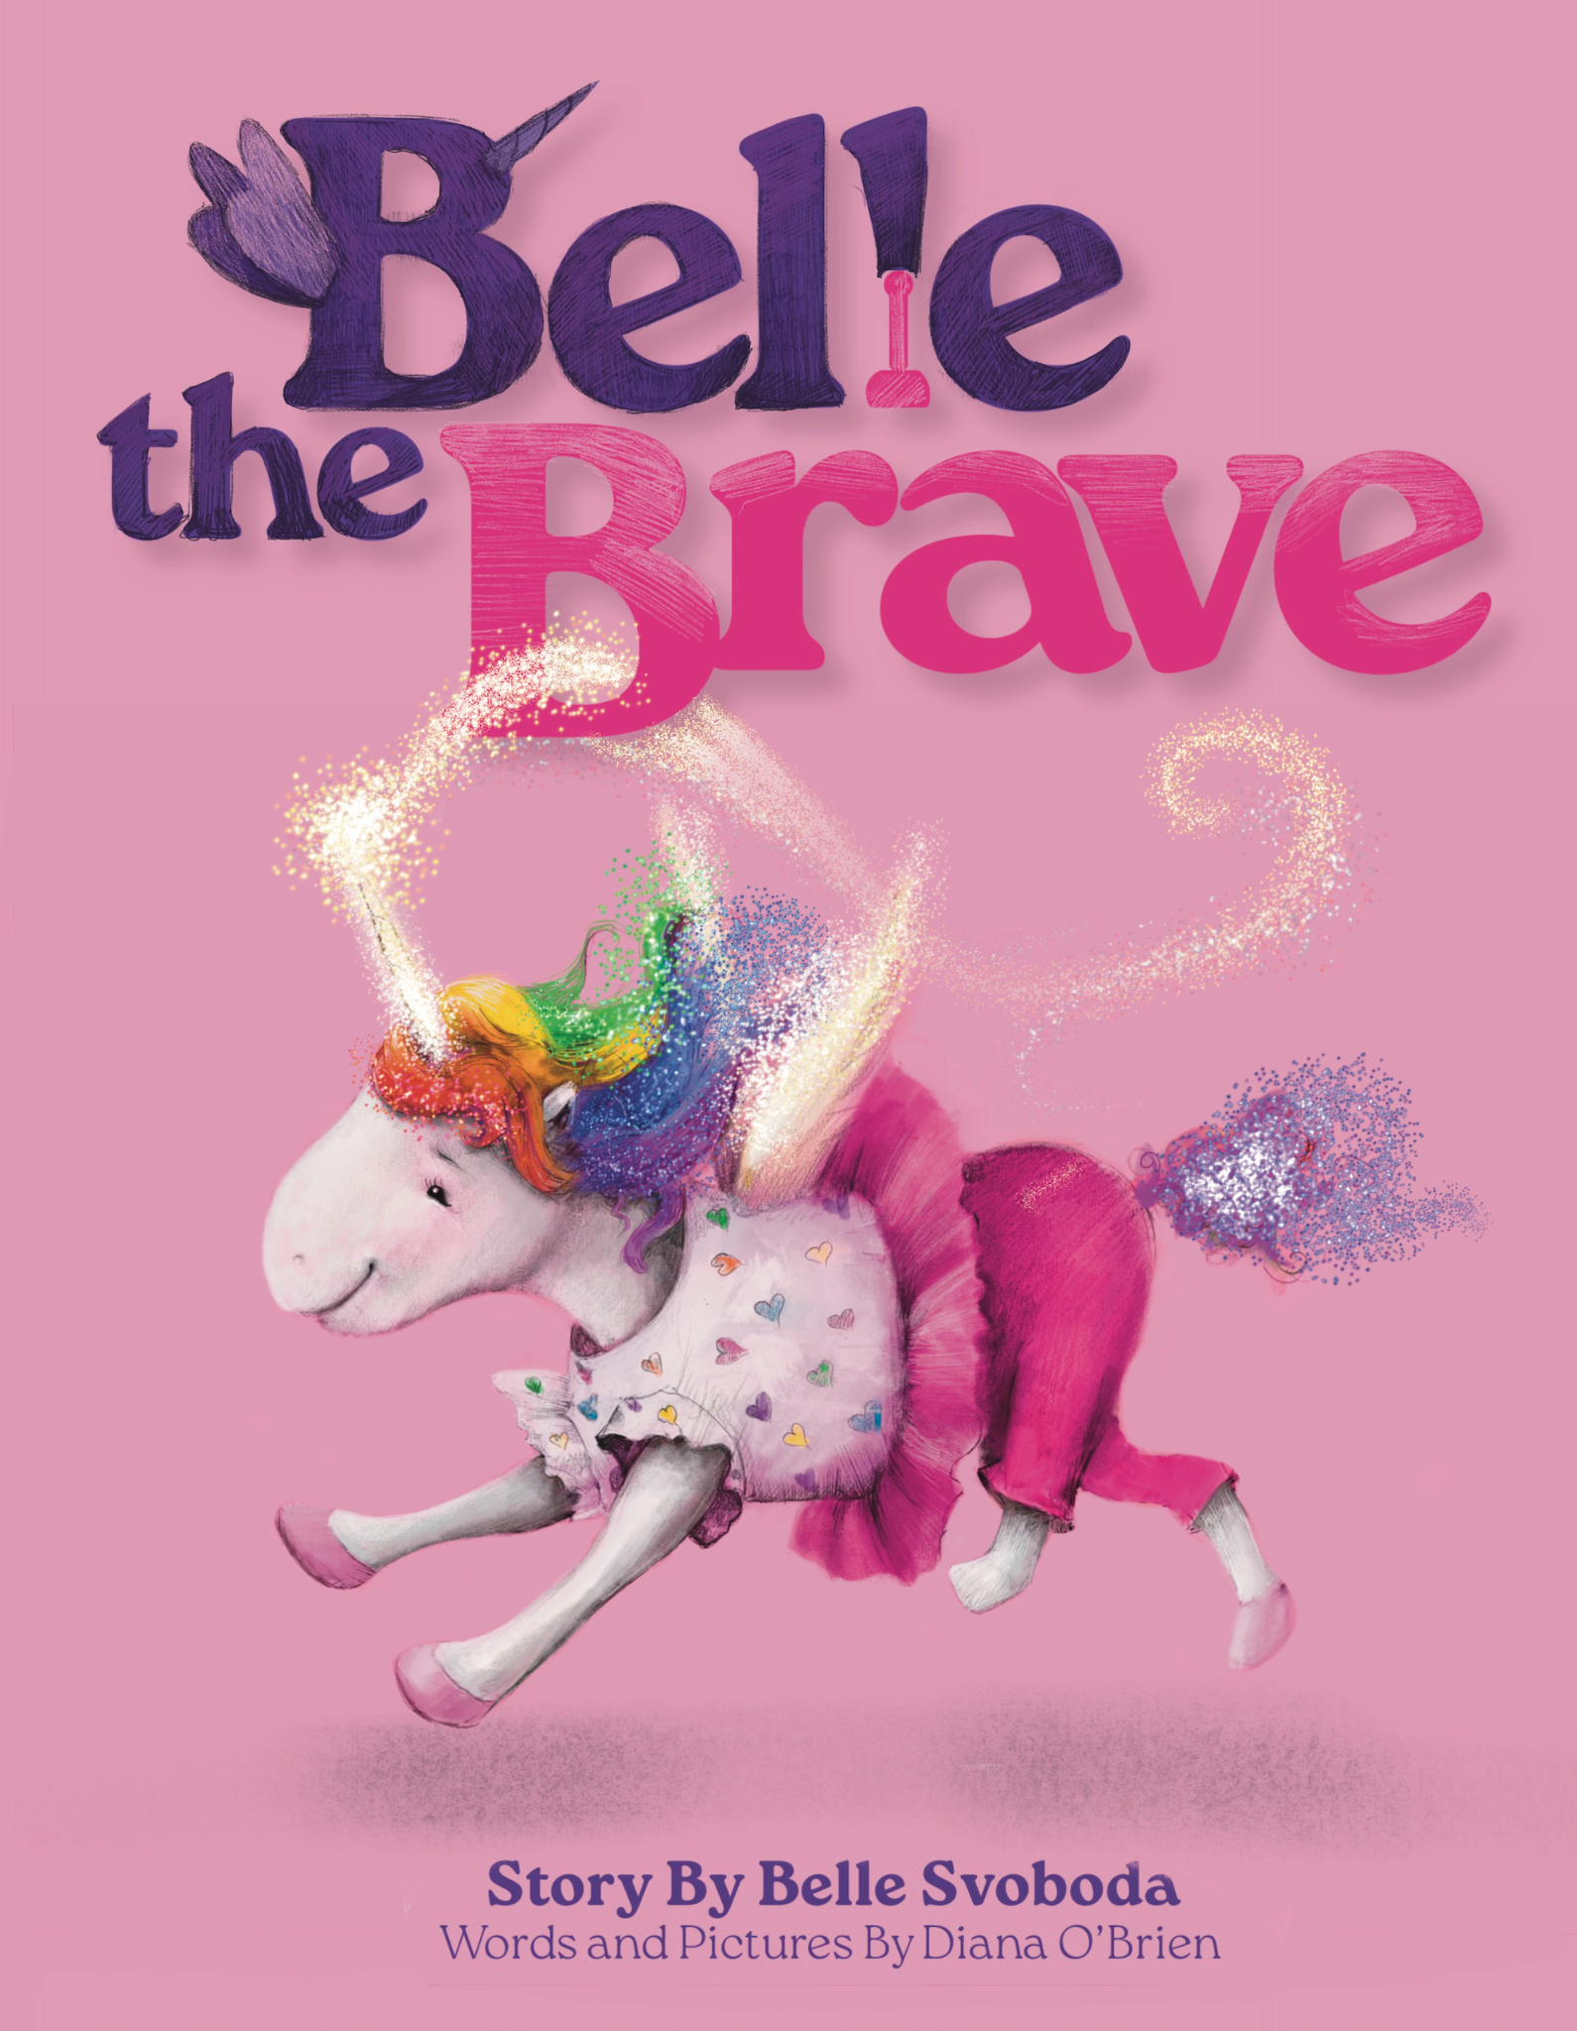
Belle The Brave
Personal loss has significantly shaped my professional path. Through grief, I encountered pivotal moments that demanded choices leading to substantial changes in my artistic, spiritual, and professional life.
In 1997, I opted for stability by pursuing an AAS in Advertising Design at FIT, eventually becoming the head of marketing for a global company. My early passion for children's books persisted, but graphic design offered more security. This decision stayed with me as I navigated my career. In 2008, I sought an MFA in Illustration at FIT, an application process my father assisted with. After facing rejection and later losing my father, I found healing by painting murals in children's hospitals across the U.S. with the nonprofit Splashes of Hope. This experience eventually enriched my portfolio, leading to my acceptance into the program in 2015.
The birth of my daughter, Grace, in 2017, and my son, Declan, during the 2020 pandemic, marked personal milestones. With my husband's support, I started working toward my MFA in 2021. Grace's first-grade experience introduced us to Belle Svoboda, who inspired my book project. Working with Belle and her family transformed the project into a team effort, culminating in "Belle The Brave," a book resonating across all ages. Belle's courage in facing her illness has inspired our family mantra, "If Belle can do it, so can I!"
Authors of Hope, a small, independent publishing house, was born from a desire to empower seriously ill children by sharing their stories, offering them control over their narratives and providing hope and understanding to readers.
This journey has not only transformed my portfolio but deepened my faith, leading to personal healing and a reinvigorated spirit.
Detail of one of your images

Slide 3
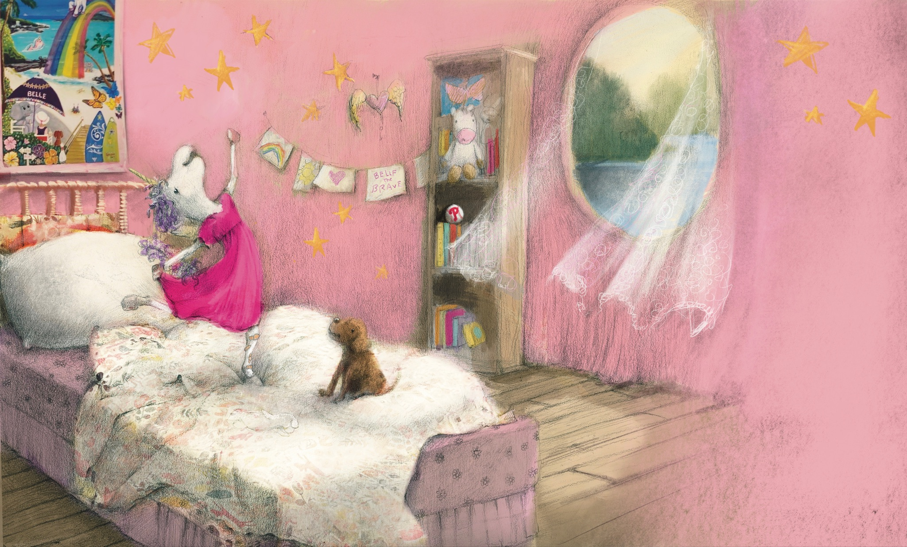
Final Art Sample 3
Belle The Brave: Upon Waking
Graphite and Digital Watercolor
18x12

Slide 4
Final Art Sample 3
Belle The Brave: Nervous in Class
Graphite and Digital Watercolor
9x12

Slide 5
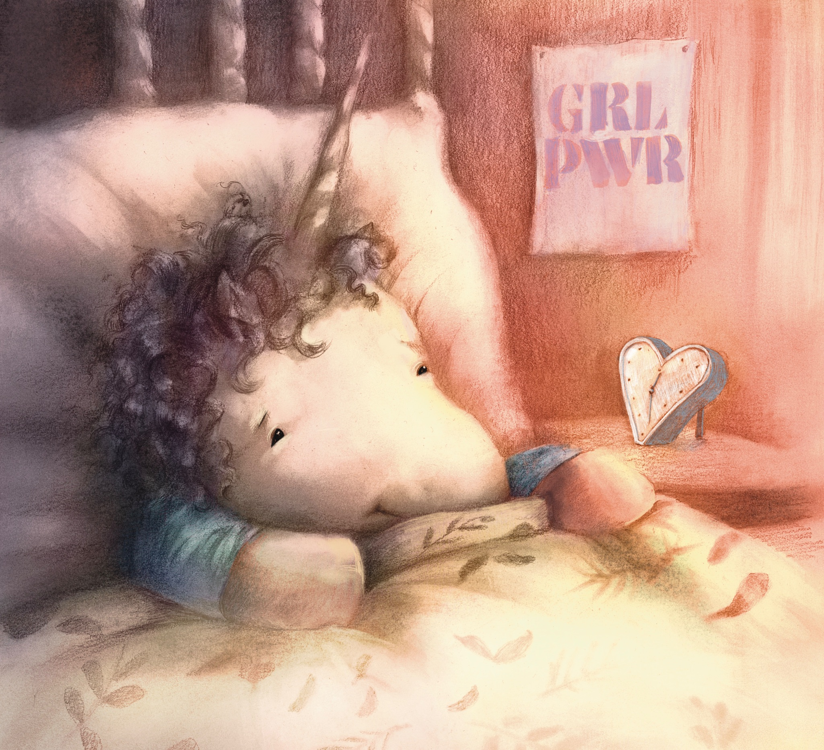
Final Art Sample 1
Belle The Brave: Night Before Surgery
Graphite and Digital Watercolor
9x12

Slide 6
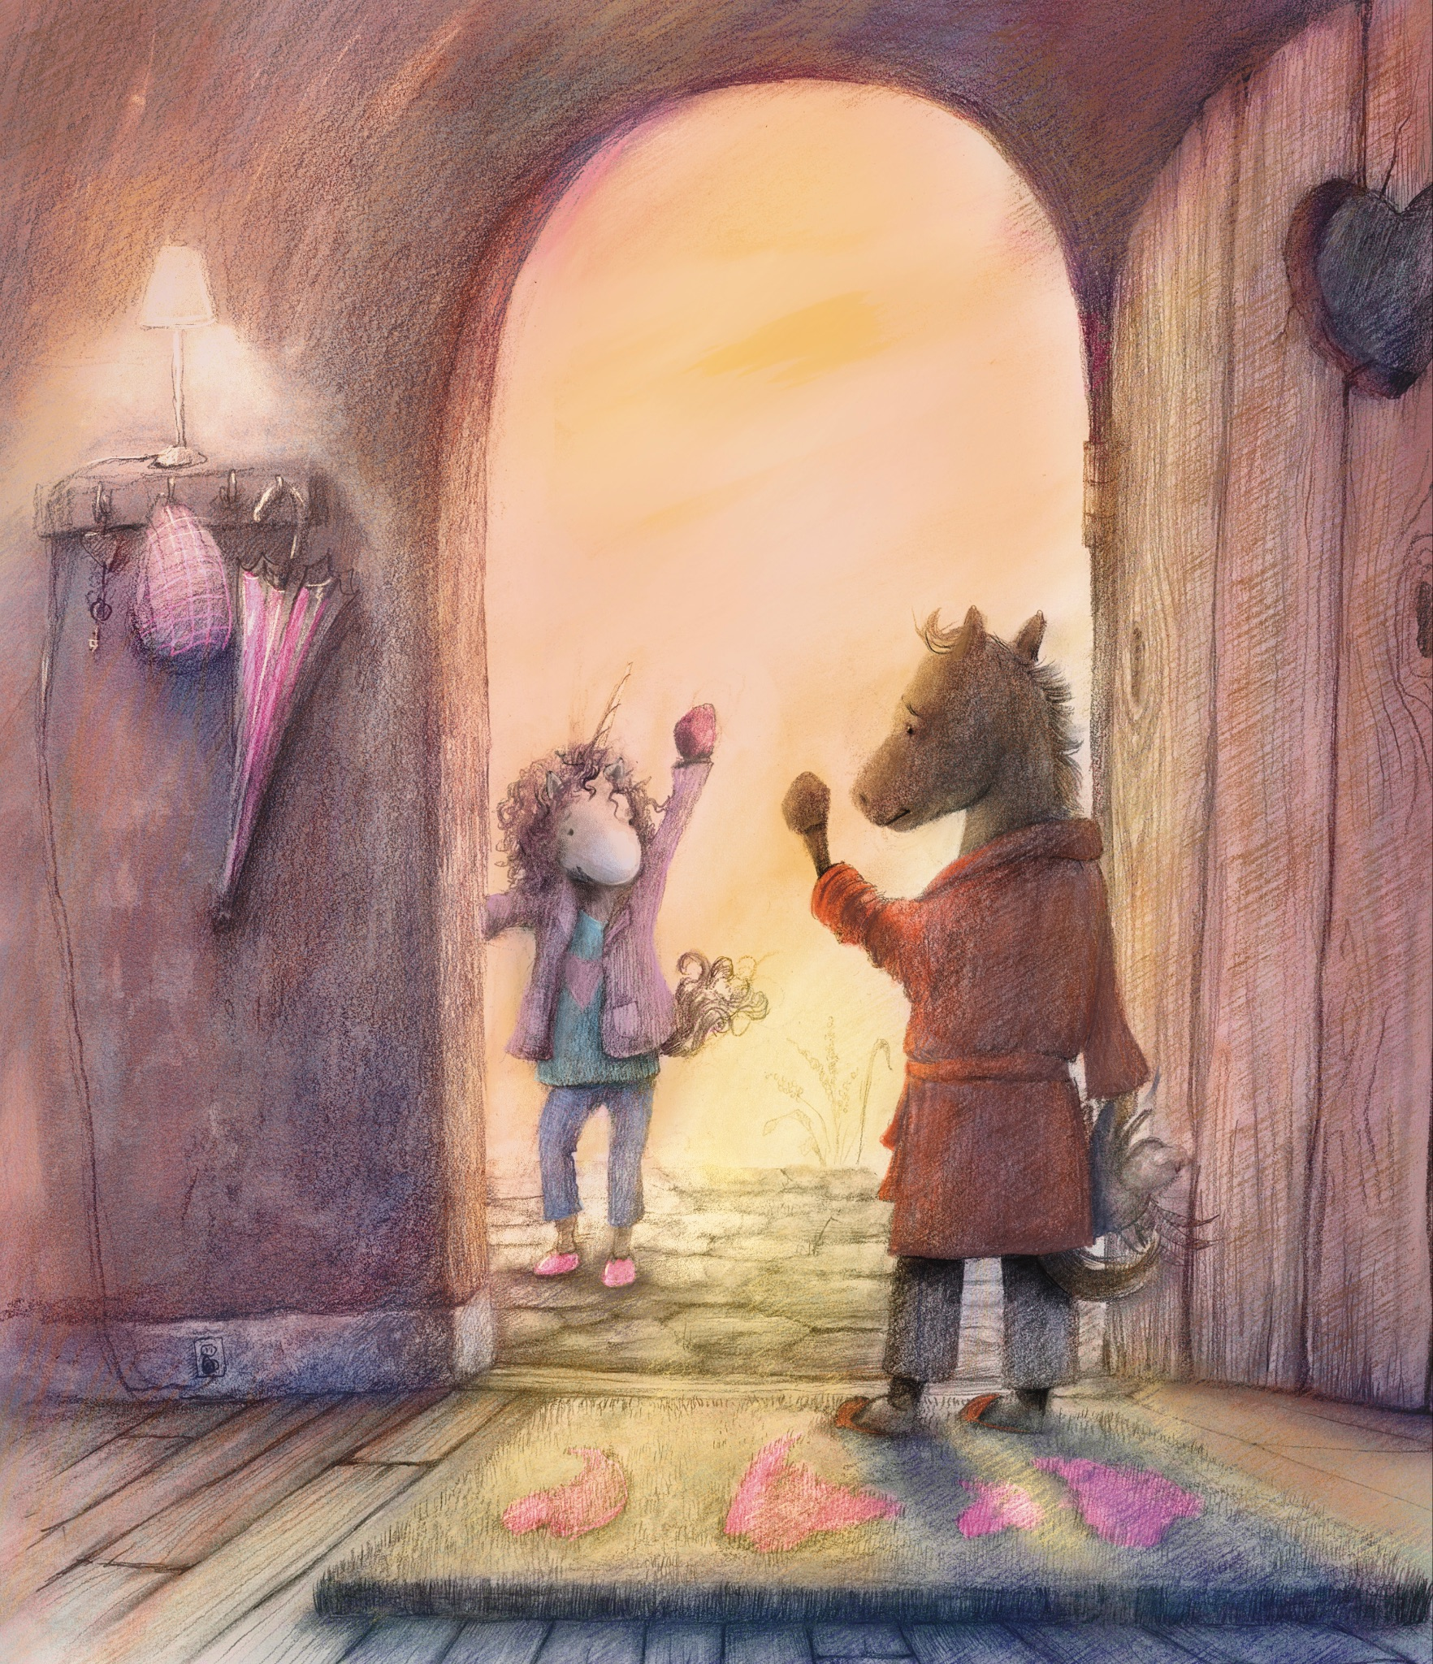
Final Art Sample 2
Belle The Brave: Morning Goodbye
Graphite and Digital Watercolor
9x12

Slide 7
