Slide 1
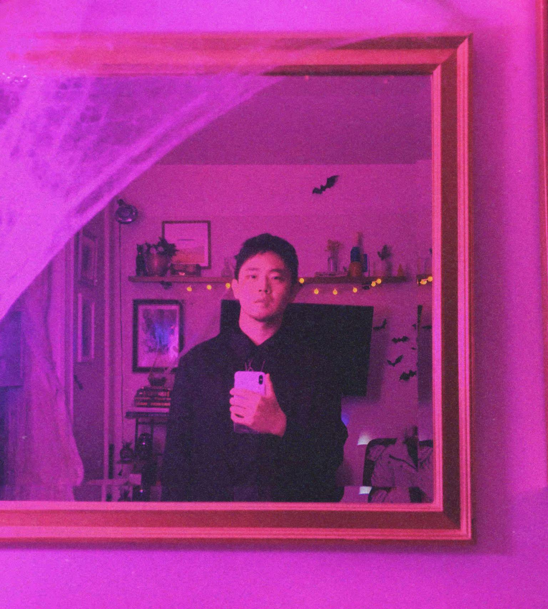
Xiao Lyu
Xiao Lyu is a visual artist based in New York City. He finds joy in the dynamic interplay of different artistic disciplines and works with a broad spectrum of skills encompassing illustration, photography, gaming art, and graphic and concept design. He earned his BFA in Art and Design at the China Academy of Art, worked for years as a graphic designer, gaming artist, and art director, and also ran his own graphic studio with a partner. Now as a current MFA candidate in Illustration at the Fashion Institute of Technology, he keeps on working as a freelance visual artist with his own visual language building up which is mainly in digital but sometimes also in traditional media, and finding the balance between abstract and interpretable surreal. Select clients: P&G - Oral-B, Febreze, Alibaba, MTomorrow, Wanglaoji, Perfect World.
Email: xiaolyuart@gmail.com | xiao_lyu@fitnyc.edu
Website: xiaolyu.art
ig: @xiaolyuxiao
Photo/Headshot

Slide 2
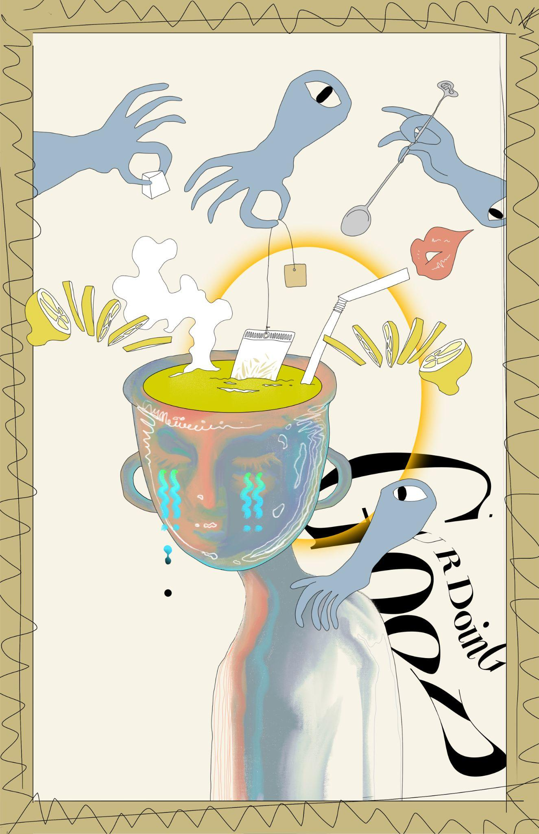
Emotional Pollutants
Our emotions and mindsets are influenced by a variety of factors in daily life. Some of them are positive, such as friendships built on mutual assistance, unwavering support, and love; some of them are negative, such as carrying so many expectations on yourself, the one who talks sweet but stabs you in the back, and the fear of falling behind the majority. These negative factors generate what I think of as “emotional pollution.” Over time, these pollutants can gradually contaminate our consciousness, disrupting our mental health. They reflect outwardly, manifesting as fatigue, negativity, depression, irritability, and emitting negative vibes.
This series visualizes how I experience and process different phenomena I consider to be “emotional pollutants.”
Detail of one of your images

Slide 3
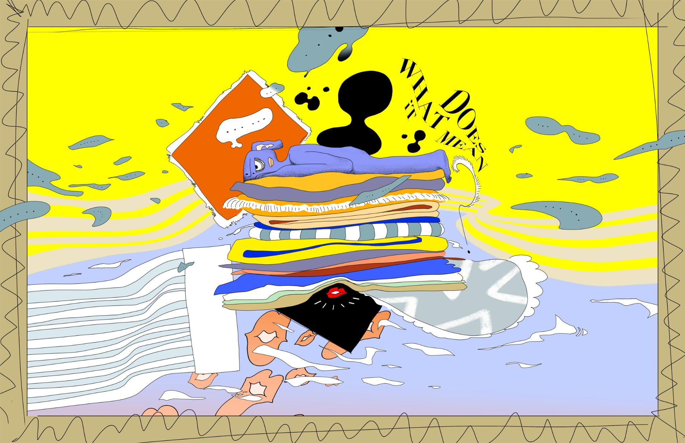
Final Art Sample 1
Implicit Cues
Digital
17x11
Just like in The Princess and the Pea, people expect the princess to be sensitive enough to sense what’s hiding underneath, implicit cues also force you to keep the sensitivity and keep guessing the hidden lyrics behind what's been said. So annoying and itchy.

Slide 4
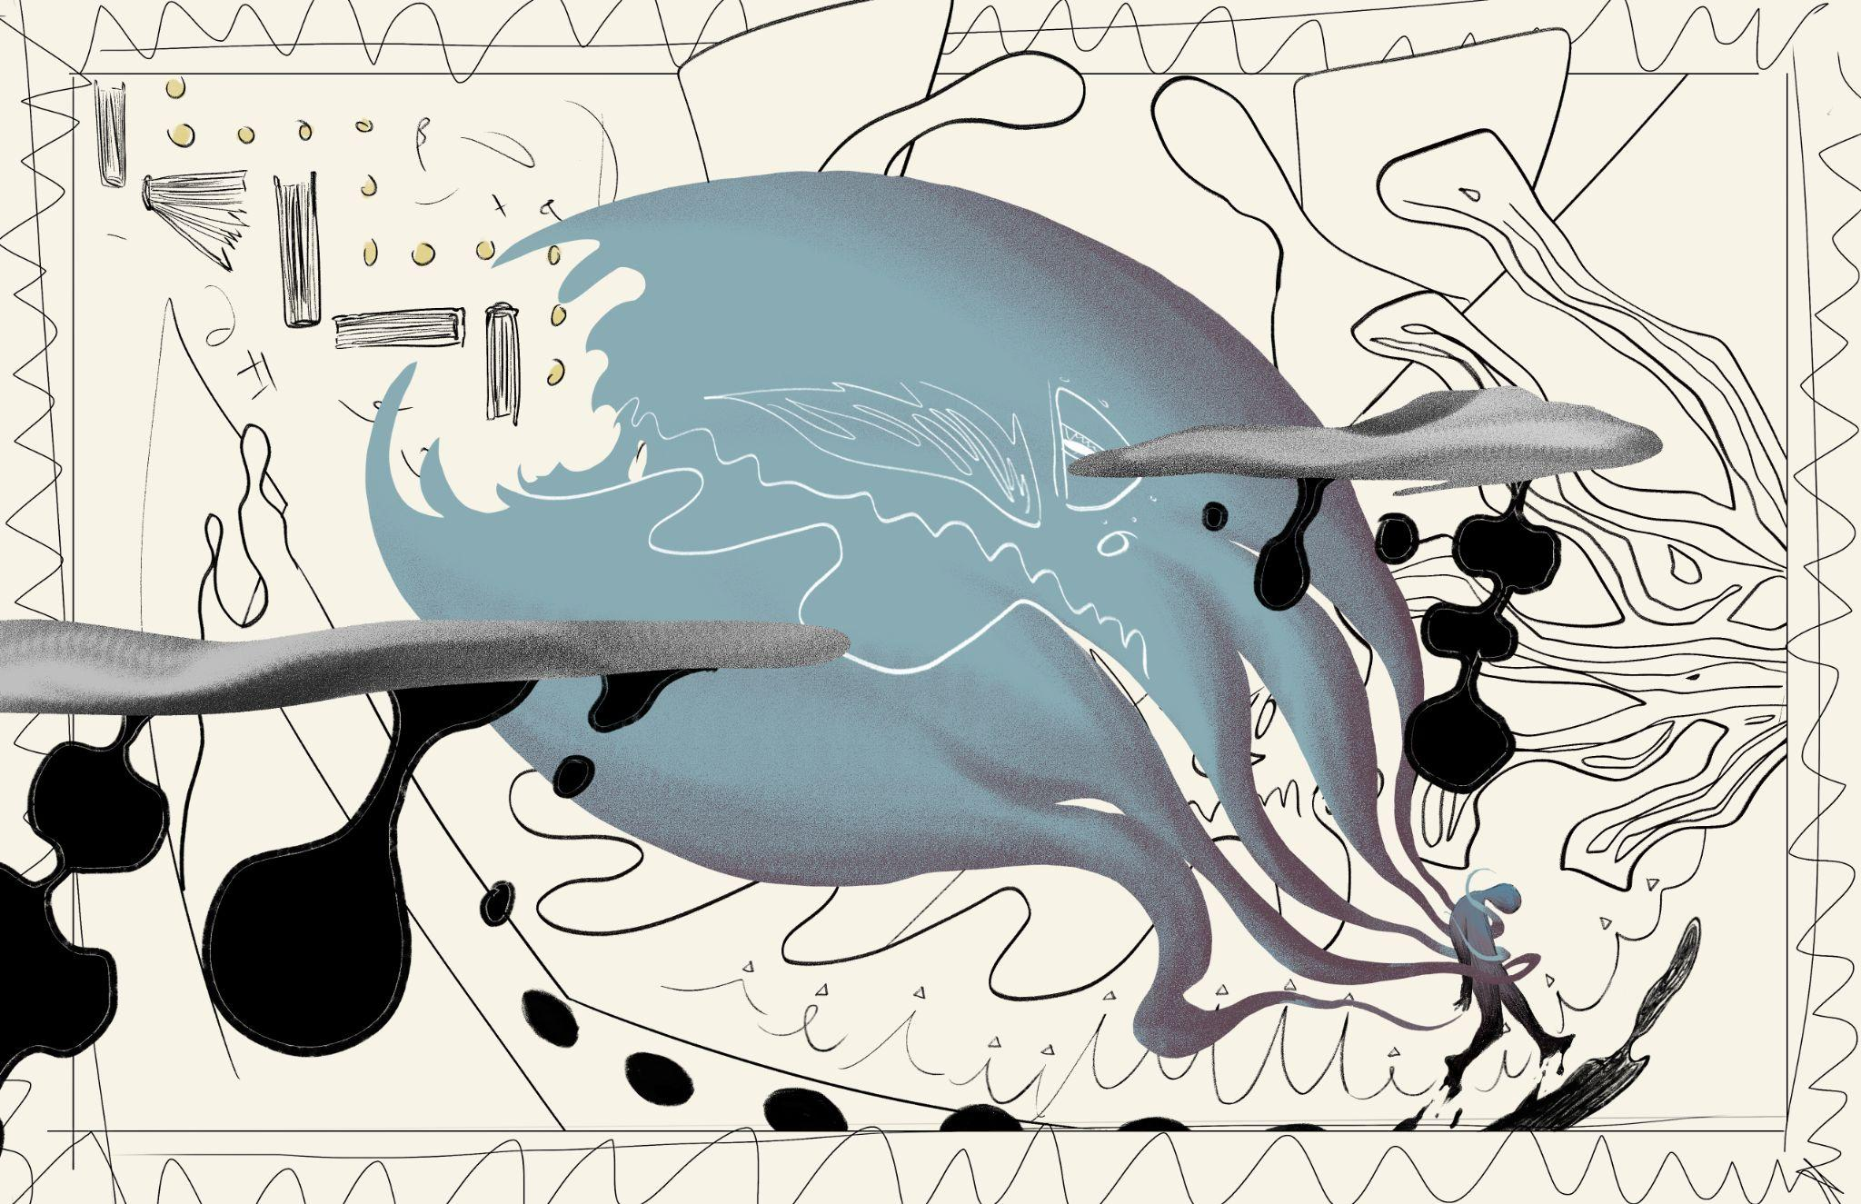
Final Art Sample 2
Expectations
Digital
17x11
The undue expectations accumulating from ppl around you will become pressures and burdens that
tangling you like a giant octopus.

Slide 5
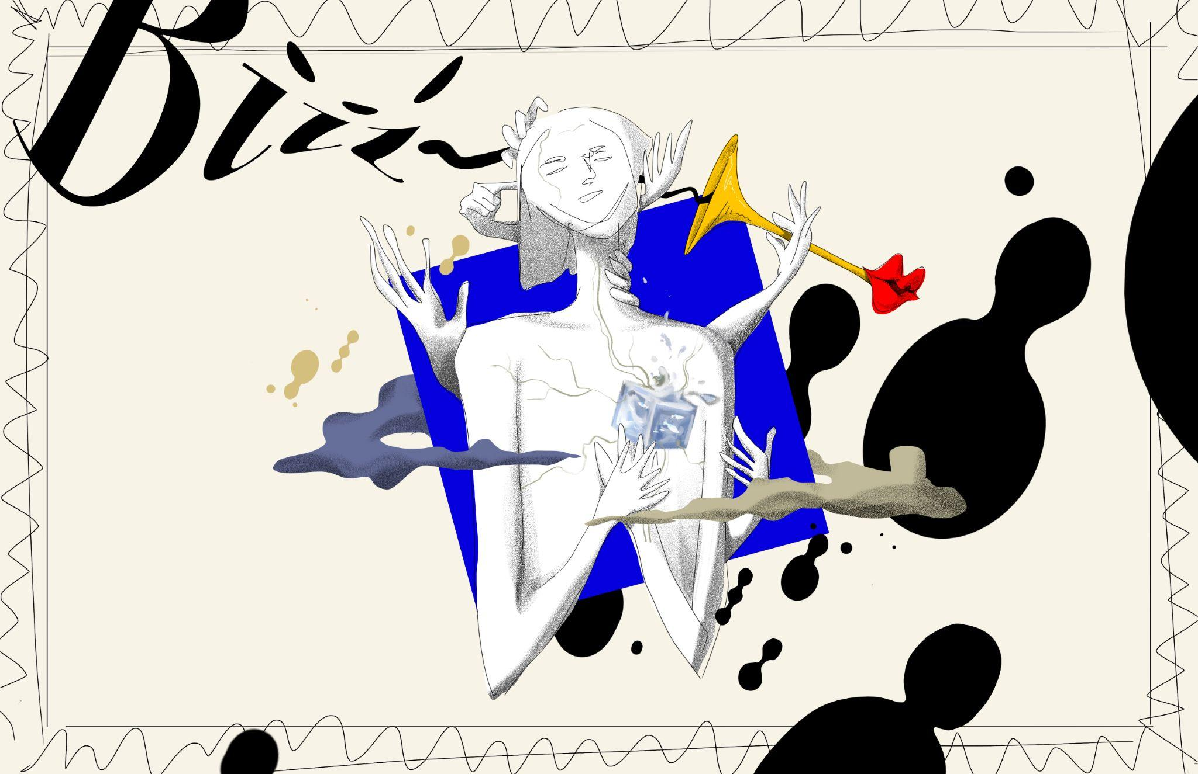
Final Art Sample 3
Ocean Heart
digital
17x11
hope you can find peace,
gain what you deserve,
stay who you are
with your pure mindset,
in this world full of chaos.

